Slide 1
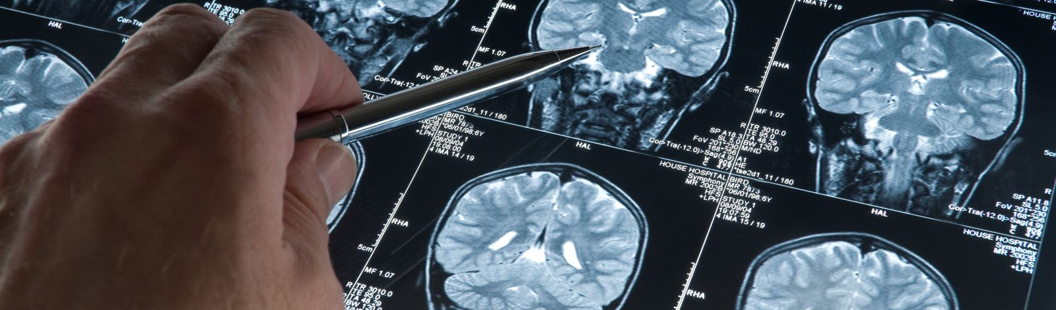
Brain Tumor Detector
Capstone Project On
Presented By - Shivam Mishra
Supervised By – Mr. Rithik Raj Vaishya

Slide 2


Introduction
Normal cells grow in a controlled manner as new cells replace old or damaged ones. For reasons not fully understood, tumor cells reproduce uncontrollably.
A primary brain tumor is an abnormal growth that starts in the brain and usually does not spread to other parts of the body. Primary brain tumors may be benign or malignant.
A benign brain tumor grows slowly, has distinct boundaries, and rarely spreads. Although its cells are not malignant, benign tumors can be life threatening if located in a vital area.
A malignant brain tumor grows quickly, has irregular boundaries, and spreads to nearby brain areas. Although they are often called brain cancer, malignant brain tumors do not fit the definition of cancer because they do not spread to organs outside the brain and spine.
Metastatic (secondary) brain tumors begin as cancer elsewhere in the body and spread to the brain. They form when cancer cells are carried in the blood stream. The most common cancers that spread to the brain are lung and breast.

Slide 3
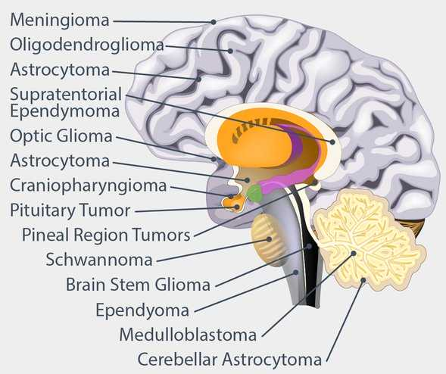
Types of Brain Tumor
Gliomas and related brain tumors. Gliomas are growths of cells that look like glial cells. The glial cells surround and support nerve cells in the brain tissue. Types of gliomas and related brain tumors include astrocytoma, glioblastoma, oligodendroglioma and ependymoma. Gliomas can be benign, but most are malignant. Glioblastoma is the most common type of malignant brain tumor.
Choroid plexus tumors. Choroid plexus tumors start in cells that make the fluid that surrounds the brain and spinal cord. Choroid plexus tumors can be benign or malignant. Choroid plexus carcinoma is the malignant form of this type of brain tumor. It's more common in children.
Embryonal tumors. Embryonal tumors begin in cells that are left over from fetal development. Embryonal tumors are malignant brain tumors that happen most often in babies and young children. The most common type of embryonal tumor is medulloblastoma. It's usually located in the lower back part of the brain, called the cerebellum.
Germ cell tumors. Germ cell tumors start in reproductive cells, called germ cells, that go on to become the sperm and egg cells.. When germ cell tumors happen in the brain, they're often located near the pineal gland or the pituitary gland. Germ cell tumors are mostly benign. They're more common in children.

Slide 4
Types of Brain Tumor
Pineal tumors. Pineal tumors start in and around the brain's pineal gland. The pineal gland is located in the center of the brain. It makes a hormone called melatonin that helps with sleep. Pineal tumors can be benign or malignant. Pineoblastoma is a malignant type of pineal tumor that's most common in children.
Meningiomas. Meningiomas are brain tumors that start in the membranes around the brain and spinal cord. Meningiomas are usually benign, but sometimes they can be malignant. Meningiomas are the most common type of benign brain tumor.
Nerve tumors. Nerve tumors are growths that happen in and around nerves. The most common type that happens in the head is acoustic neuroma, also called schwannoma. This benign tumor is located on the main nerve that connects the inner ear to the brain.
Pituitary tumors. Brain tumors can begin in and around the pituitary gland. This small gland is located near the base of the brain. Most tumors that happen in and around the pituitary gland are benign. Pituitary tumors happen in the pituitary gland itself. Craniopharyngioma is a type of brain tumor that happens near the pituitary gland.
Other brain tumors. Many other types of rare tumors can happen in and around the brain. Tumors can start in the muscles, blood vessels and connective tissue around the brain. Tumors can form in the bones of the skull. Malignant brain tumors can start from the germ-fighting immune system cells in the brain. This type of brain cancer is called primary central nervous system lymphoma.

Slide 5
Symptoms
The signs and symptoms of a brain tumor depend on the brain tumor's size and location. Symptoms also might depend on how fast the brain tumor is growing, which is also called the tumor grade.
General signs and symptoms caused by brain tumors may include:
Headache or pressure in the head that is worse in the morning.
Headaches that happen more often and seem more severe.
Headaches that are sometimes described as tension headaches or migraines.
Eye problems, such as blurry vision, seeing double or losing sight on the sides of your vision.
Losing feeling or movement in an arm or a leg, Trouble with balance.
Speech problems, Feeling very tired, Confusion in everyday matters, Memory problems, Hearing problems, Nausea or vomiting, Feeling very hungry and gaining weight..
Having trouble following simple commands.
Personality or behavior changes.
Seizures, especially if there is no history of seizures.
Dizziness or a sense that the world is spinning, also called vertigo.

Slide 6
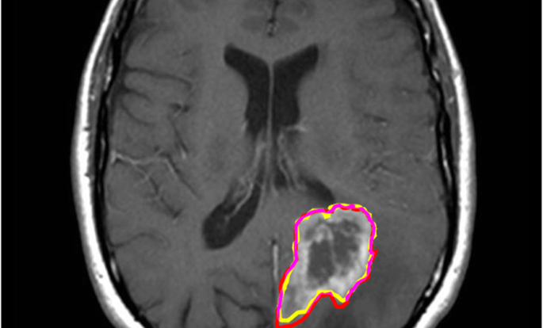
Objective
To develop an accurate and efficient model capable of automatically detecting and localizing brain tumors from MRI images.
This model aims to assist medical professionals in the timely diagnosis and treatment planning for patients with brain tumors by providing a reliable tool for automated detection and segmentation of tumors.

Slide 7
Methodology
Data Collection
Data Preprocessing
Split Dataset
Model Selection
Results
Evaluating
Training
Model Development
-BY SHIVAM MISHRA
7

Slide 8
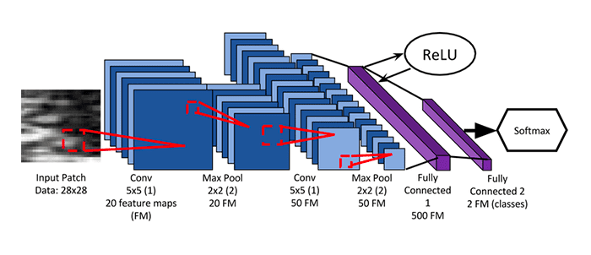
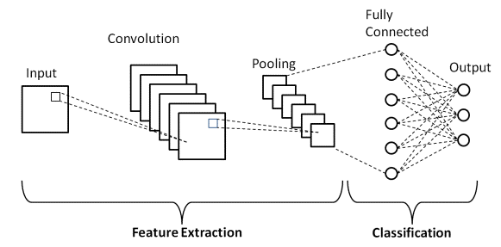
Models & Frame works used in this project
CNN: CNNs can automatically learn and extract meaningful features from MRI images, such as edges, textures, and shapes, which are crucial for accurate tumor detection. CNN architectures are capable of automatically learning and adapting to different variations and complexities present in MRI scans, making them a powerful tool for detecting brain tumors with high accuracy and efficiency.
PyTorch: PyTorch, a popular deep learning framework, is well-suited for MRI brain tumor detection tasks with CNNs due to its flexibility, ease of use, and strong support for building complex neural network architectures. PyTorch offers efficient GPU acceleration and CPU, allowing for faster training and inference of deep learning models, which is beneficial when working with large MRI datasets.
8

Slide 9
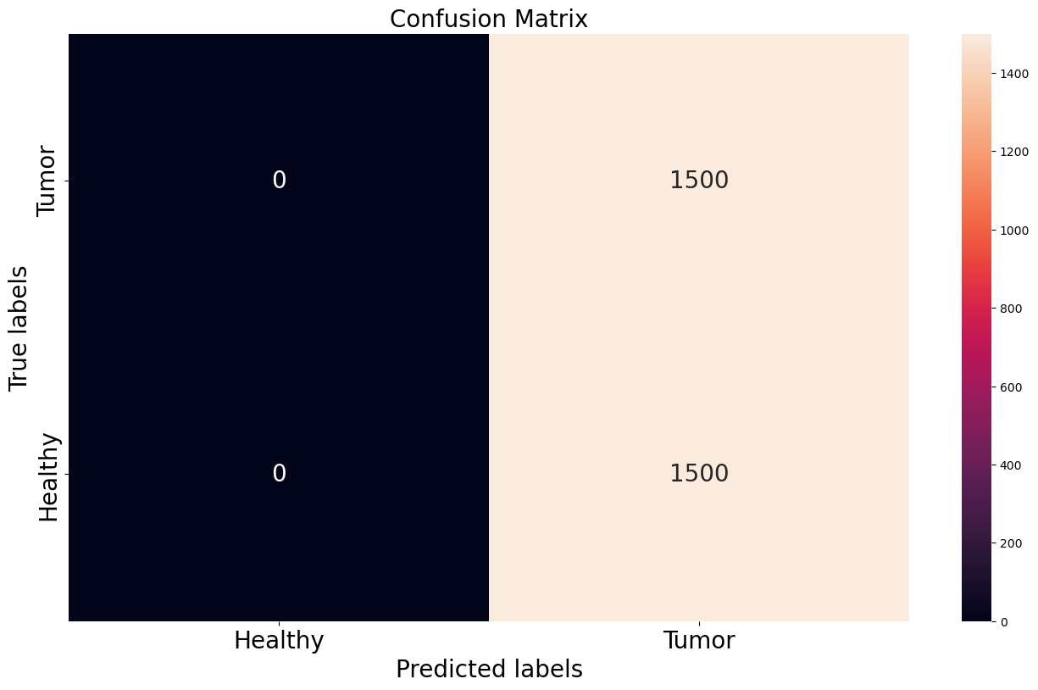

Result
Accuracy
Before | After
50% | 99%

Slide 10
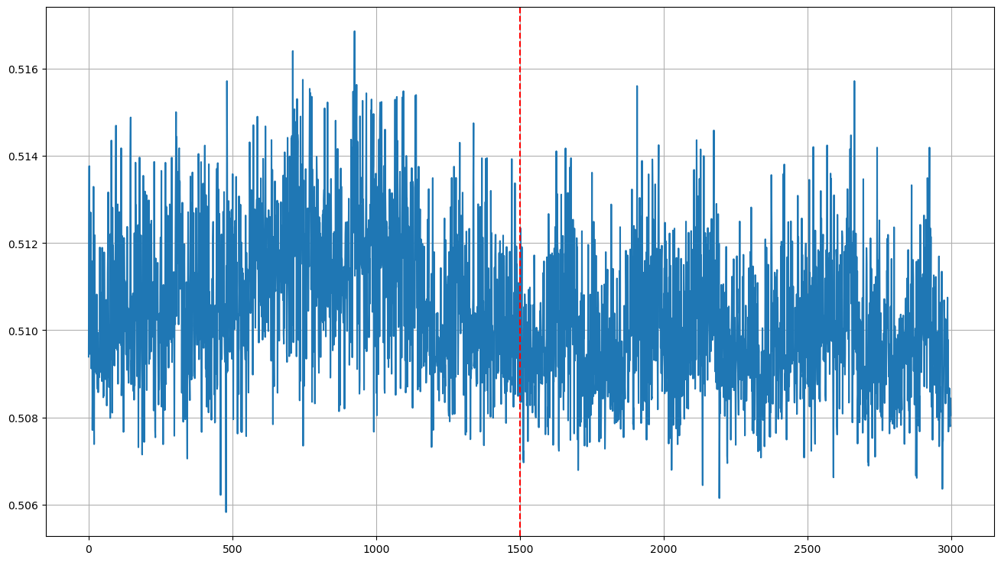
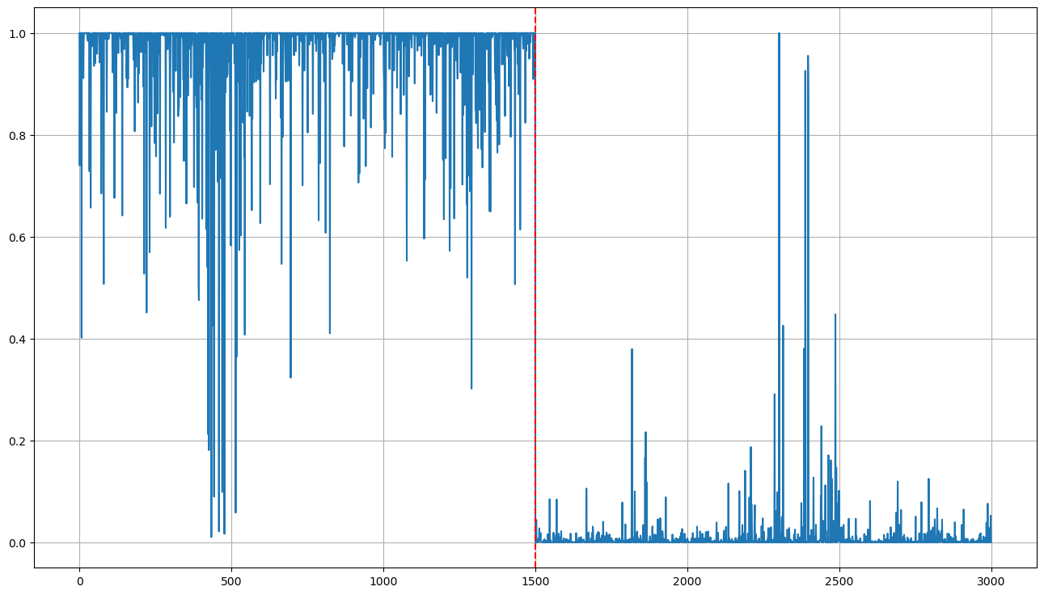
Before
After

Slide 11
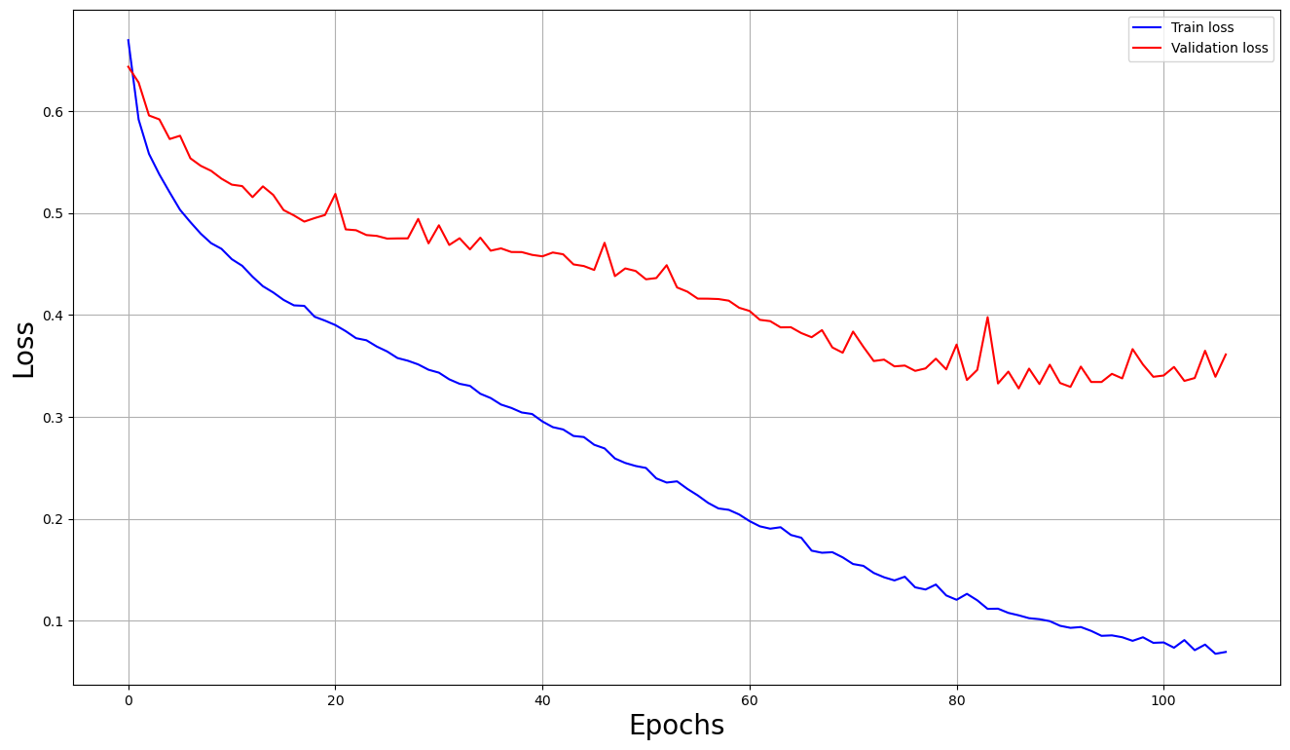
TRAIN LOSS VS VALIDATION LOSS

Slide 12
Conclusion
Based on the provided results, it seems that the training loss consistently decreases over epochs, indicating that the model is learning from the training data. Similarly, the validation loss initially decreases but then stabilizes and starts to increase slightly after a certain point.
As per the accuracy also it shows the model is overfitting model.
To avoid this overfitting problem I have to do some hyper parameter tunning (have to work on number of layers, networks, filters).

Slide 13
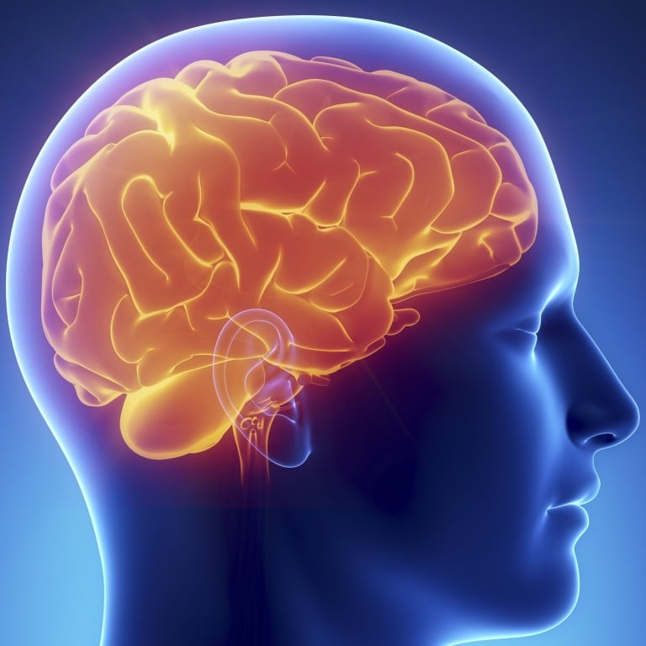
Thank you!!!

